Slide 1
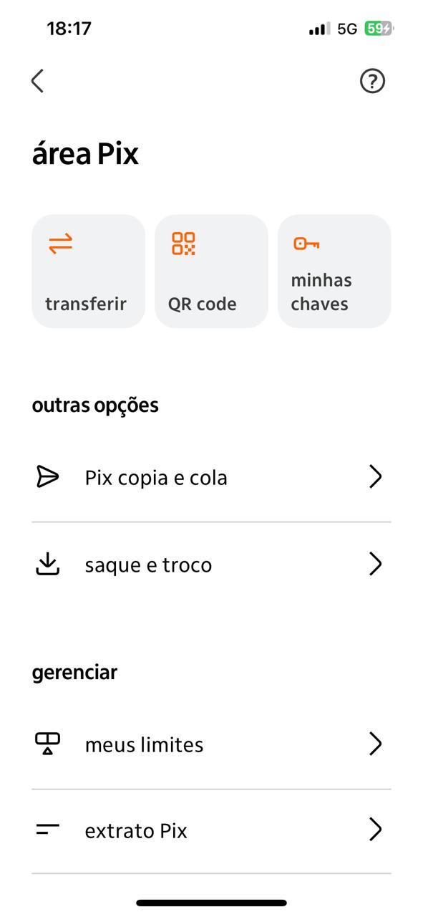
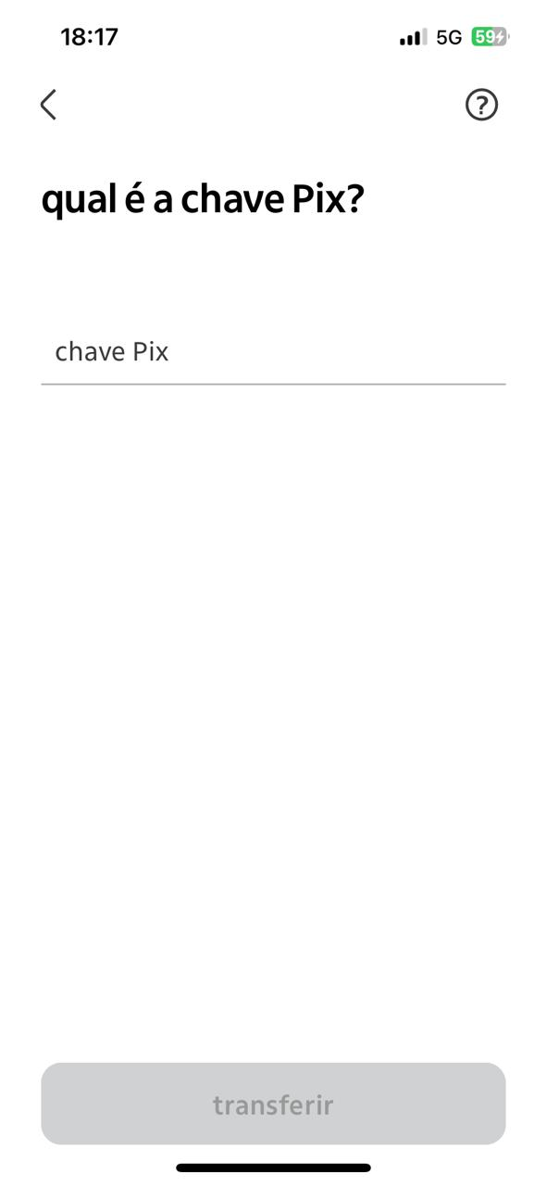

06:17pm
06:17pm
FedNow
FedNow Key:
FedNow Key
Send
Activity
History
Receipts
Send

